Slide 1

Stage 1 A Tale of Three Windows Course Designer: Marcel Englmaier
A Tale of Three Windows is a 21 round, 105 point Comstock Long course. There are 10 IPSC targets and 1 steel target. The best two hits per target will score. Steel must fall to score. The start signal is audible.
The Handgun start position is standing with heels touching either set of marks and wrists below belt. Handgun loaded and holstered. The PCC start position is standing with heels touching either set of marks. PCC loaded, stock on belt, muzzle pointing down range.
On the audible start signal, engage all targets from within the shooting area. Knockdown steel closes center window and opens outer windows.

Slide 2
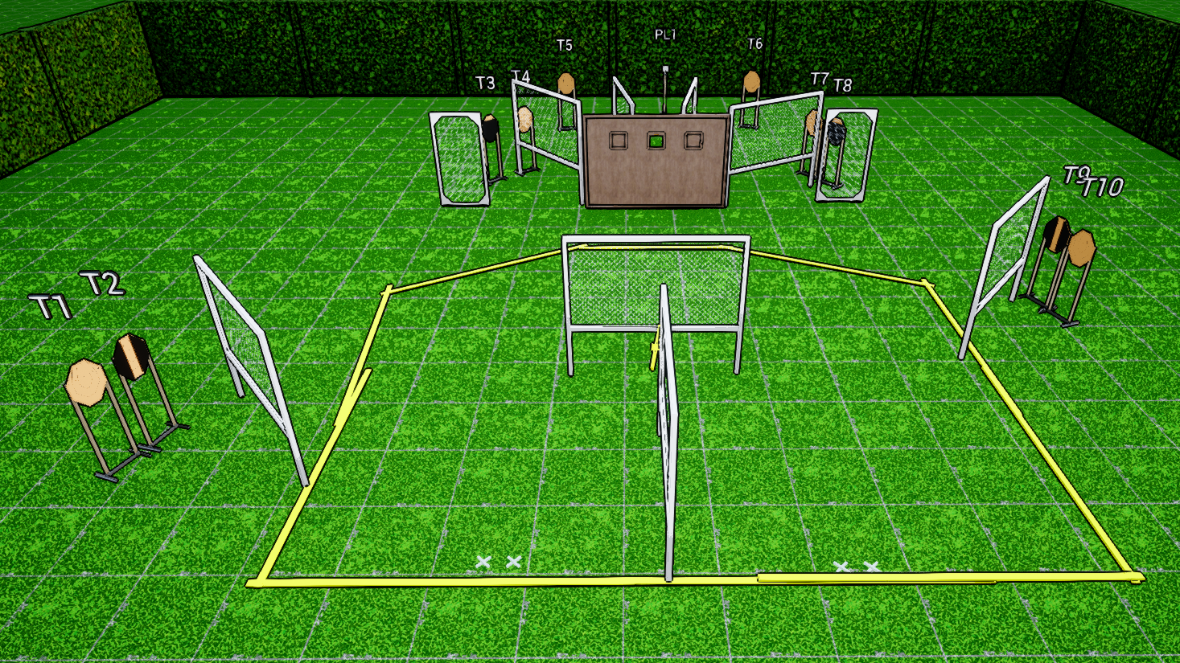
 | Stage 1 A Tale of Three Three Windows Course Designer: Marcel Englmaier

